Slide 1

Special Topic: Cybersecurity
Chapter 6: Network Security 2

Slide 2

1. The Application Layer and DNS
The physical, link, network, and transportation layers provide a basic underlying network infrastructure that allows applications to communicate with each other.
It is in the application layer that most of the action of the Internet takes place.

Slide 3
1.1 A Sample of Application-Layer Protocols
There are many application-layer protocols designed to perform a number of important tasks at Internet-scale, including the following:
Domain name system (DNS)
Hypertext transfer protocol (HTTP)
SSL/TLS
IMAP/POP/SMTP
File transfer protocol (FTP)
SOAP
Telnet
SSH

Slide 4
1.2 The Domain Name System (DNS)
The domain name system, or DNS, is a fundamental application layer protocol that is essential to the functioning of the Internet as we know it today.
DNS is a protocol that sits “behind the scenes” for every web browser and is responsible for resolving domain names, such as www.example.com, to IP addresses, such as 208.77.188.166.

Slide 5
1.2 The Domain Name System (DNS)
Domain names are arranged in a hierarchy that can be read by examining a domain name from right to left.
For example, www.example.com has a top-level domain (TLD) of com, with example.com being a subdomain of com, and www.example.com being a subdomain of example.com.

Slide 6
Domain Name Registration
There are two primary types of top-level domains in use today:
Generic top-level domains, such as the popular domains .com, .net, .edu, and .org
Country-code top-level domains, such as .au (Australia), .de (Germany), .it (Italy), and .pt (Portugal), with use restricted to entities within a specific country
Domain names are registered and assigned by domain-name registrars, which are organizations accredited by the Internet Corporation for Assigned Names and Numbers (ICANN), the same group responsible for allocating IP address space, or a country-code top-level domain that has been granted authority to designate registrars.

Slide 7
Domain Name Registration
There are two primary types of top-level domains in use today:
Generic top-level domains, such as the popular domains .com, .net, .edu, and .org
Country-code top-level domains, such as .au (Australia), .de (Germany), .it (Italy), and .pt (Portugal), with use restricted to entities within a specific country
Domain names are registered and assigned by domain-name registrars, which are organizations accredited by the Internet Corporation for Assigned Names and Numbers (ICANN), the same group responsible for allocating IP address space, or a country-code top-level domain that has been granted authority to designate registrars.

Slide 8
Domain Name Registration
Because of the revenue potential of memorable domain names, a practice known as cybersquatting or domain squatting has become common-place.
In such a scenario, a person registers a domain name in anticipation of that domain being desirable or important to another organization, with the intent of selling the domain to that organization for what can sometimes be a significant profit.

Slide 9
Inner workings of a DNS server
How a DNS Server (Domain Name System) works.
https://www.youtube.com/watch?v=mpQZVYPuDGU

Slide 10
How DNS is Organized
The hierarchical nature of domain names is reflected in the way the Internet infrastructure supporting the DNS system works. That is, to resolve a domain name to its corresponding IP address, the DNS hierarchy is used to query a distributed system of DNS servers, known as name servers.
At the top of the name-server hierarchy are the root name servers, which are responsible for top-level domains, such as .com, .it, .net, and .org.
Specifically, the root name servers store the root zone database of records indicating the authoritative name server of each top-level domain. This important database is maintained by ICANN.

Slide 11
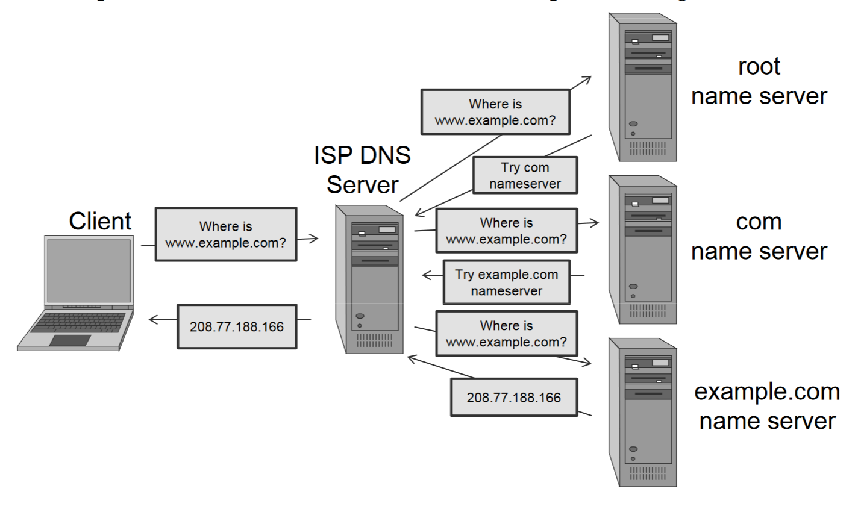
How DNS Queries Work

Slide 12
DNS Caching
In order to reduce DNS traffic and resolve domain names more efficiently, DNS features a caching mechanism that allows both clients and lower-level DNS servers to keep a DNS cache, a table of recently received DNS records.
This caching system overcomes the problem of massive amounts of traffic directed at root name servers by allowing lower-level name servers to resolve queries

Slide 13
1.3 DNS Attacks
Consider what could happen if DNS were somehow subverted so that an attacker could control how DNS requests resolve.
An attacker could cause requests for web sites to resolve to false IP addresses of his own malicious servers, leading the victim to view or download undesired content, such as malware.
Such an attack is known as pharming.

Slide 14
1.3 DNS Attacks
One of the main uses of pharming is to resolve a domain name to a web site that appears identical to the requested site, but is instead designed for a malicious intent.
Such an attack is known as phishing and it can be used to try to grab usernames and passwords, credit card numbers, and other personal information.

Slide 15
DNS Cache Poisoning
Some DNS attacks are made possible by a technique known as DNS cache poisoning.
In this technique, an attacker attempts to trick a DNS server into caching a false DNS record, which will then cause all downstream clients issuing DNS requests to that server to resolve domains to attacker-supplied IP addresses
DNS Poisoning and Domain Hijacking
https://www.youtube.com/watch?v=c76GbfM_QsI

Slide 16
1.4 DNSSEC
Since the stopgap measures are insufficient to completely mitigate the risk of DNS cache poisoning, a new approach to DNS must be taken.
One possible solution is the adoption of DNSSEC, which is a set of security extensions to the DNS protocol that prevent attacks such as cache poisoning by digitally signing all DNS replies using public-key cryptography.
Such signatures make it infeasible for an attacker to spoof a DNS reply and thereby poison a DNS cache.

Slide 17
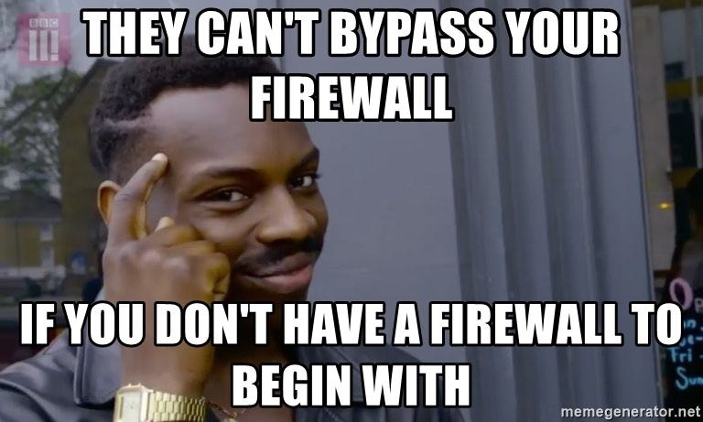
2. Firewalls
In order to protect private networks and individual machines from the dangers of the greater Internet, a firewall can be employed to filter incoming or outgoing traffic based on a predefined set of rules that are are called firewall policies.

Slide 18
2. Firewalls
Firewalls can be implemented in either hardware or software, and are typically deployed at the perimeter of an internal network, at the point where that network connects to the Internet.
In this model of network topography, the Internet is considered an untrusted zone, the internal network is considered a zone of higher trust, and any machines, like a firewall, situated between the Internet and the internal trusted network are in what is known as a demilitarized zone, or DMZ (borrowing terminology from the military).

Slide 19
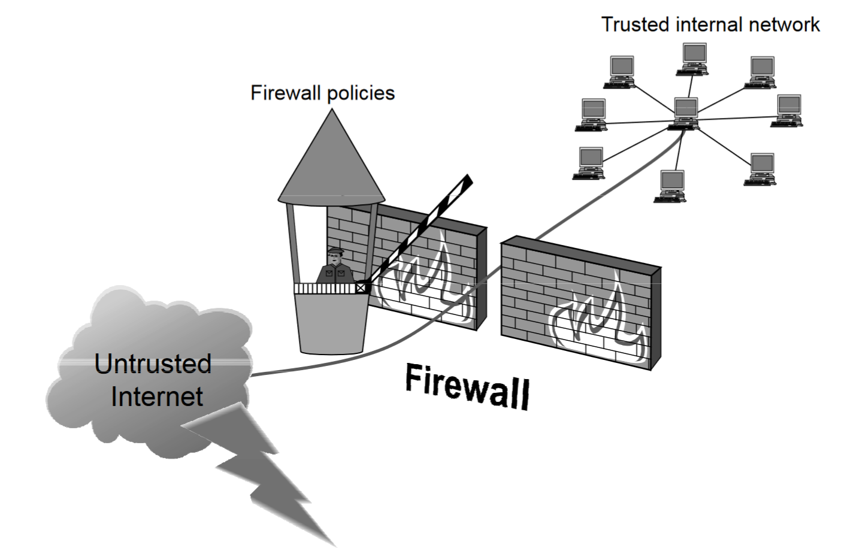
2. Firewalls

Slide 20
2.1 Firewall Policies
Packets flowing through a firewall can have one of three outcomes:
Accepted: permitted through the firewall
Dropped: not allowed through with no indication of failure
Rejected: not allowed through, accompanied by an attempt to inform the source that the packet was rejected

Slide 21
Blacklists and White-Lists
Some network administrators choose a blacklist approach, or default-allow ruleset. In this configuration, all packets are allowed through except those that fit the rules defined specifically in a blacklist.
A safer approach to defining a firewall ruleset is to implement a white-list or default-deny policy, in which packets are dropped or rejected unless they are specifically allowed by the firewall.

Slide 22
2.2 Stateless and Stateful Firewalls
One simple implementation of a firewall is known as a stateless firewall.
Such a firewall doesn’t maintain any remembered context (or “state”) with respect to the packets it is processing. Instead, it treats each packet attempting to travel through it in isolation without considering packets that it has processed previously.
While stateless firewalls provide a starting point for managing traffic flow between two untrusted zones and require little overhead, they lack flexibility and often require a choice between limited functionality and lax security.

Slide 23
Stateful Firewalls
Since stateless firewalls don’t keep track of any previous traffic, they have no way of knowing whether a particular packet is in response to a previous packet originating within the network or if it is an unprompted packet.
Stateful firewalls, on the other hand, can tell when packets are part of legitimate sessions originating within a trusted network.

Slide 24
Stateful Firewalls
Like NAT devices, stateful firewalls maintain tables containing information on each active connection, including the IP addresses, ports, and sequence numbers of packets.
Using these tables, stateful firewalls can solve the problem of only allowing inbound TCP packets that are in response to a connection initiated from within the internal network.
Once the initial handshake is complete and allowed through the firewall, all subsequent communication via that connection will be allowed, until the connection is finally terminated.

Slide 25

3. Tunneling
One way to prevent eavesdropping without changing the software performing the communication is to use a tunneling protocol.
In such a protocol, the communication between a client and server is automatically encrypted, so that useful eavesdropping is infeasible.

Slide 26
3.1 Secure Shell (SSH)
To remedy insecure protocols, SSH was created to use symmetric and public-key cryptography to communicate across the Internet using an encrypted channel.
Because of its strong security, the SSH protocol is used for a variety of tasks in addition to secure remote administration, including file transfer through the simple Secure Copy Protocol (SCP) or as part of the more full-featured Secure File-Transfer Protocol (SFTP).

Slide 27
3.1 Secure Shell (SSH)
In addition, one of the most common uses of the SSH protocol is for secure tunneling.
Because the protocol is designed such that an eavesdropper cannot deduce the contents of SSH traffic, a tunnel established using SSH will prevent many attacks based on packet sniffing.

Slide 28
3.2 IPsec
One of the fundamental shortcomings of the Internet Protocol is a lack of built-in security measures to ensure the authenticity and privacy of each IP packet. To solve this, Internet Protocl Security (IPsec) was created.
IPsec consists of several protocols, each addressing different security needs. Each protocol can operate in one of two modes, transport mode or tunnel mode.

Slide 29
3.2 IPsec
In transport mode, additional IPsec header information is inserted before the data of the original packet, and only the payload of the packet is encrypted or authenticated.
In contrast, when using tunnel mode, a new packet is constructed with IPsec header information, and the entire original packet, including its header, is encapsulated as the payload of the new packet. Tunnel mode is commonly used to create virtual private networks (VPNs)

Slide 30

3.3 Virtual Private Networking (VPN)
Virtual private networking (VPN) is a technology that allows private networks to be safely extended over long physical distances by making use of a public network, such as the Internet, as a means of transport.
VPN provides guarantees of data confidentiality, integrity, and authentication, despite the use of an untrusted network for transmission.
There are two primary types of VPNs, remote access VPN and site-to-site VPN.

Slide 31
3.3 Virtual Private Networking (VPN)
Remote access VPNs allow authorized clients to access a private network that is referred to as an intranet.
To accomplish this, the organization sets up a VPN endpoint, known as a network access server, or NAS. Clients typically install VPN client software on their machines, which handle negotiating a connection to the NAS and facilitating communication.

Slide 32
3.3 Virtual Private Networking (VPN)
Site-to-site VPN solutions are designed to provide a secure bridge between two or more physically distant networks.
VPN provides the same security but uses the Internet for communication rather than relying on a private physical layer.
To create a site-to-site VPN connection, both networks have a separate VPN endpoint, each of which communicates with the other and transmits traffic appropriately.
VPN (Virtual Private Network) Explained
https://www.youtube.com/watch?v=R-JUOpCgTZc

Slide 33
4. Intrusion Detection
An intrusion detection system (IDS) is a software or hardware system that is used to detect signs of malicious activity on a network or individual computer.
The functions of an IDS are divided between IDS sensors, which collect real-time data about the functioning of network components and computers, and an IDS manager, which receives reports from sensors.

Slide 34
4. Intrusion Detection
The IDS manager compiles data from the IDS sensors to determine if an intrusion has occurred.
This determination is usually based on a set of site policies, which are sets of rules and statistical conditions that define probable intrusions.
If an IDS manager detects an intrusion, then it sounds an alarm so that system administrators can react to a possible attack.

Slide 35
Intrusions
An IDS is designed to detect a number of threats, including the following:
masquerader: an attacker who is falsely using the identity and/or credentials of a legitimate user to gain access to a computer system or network
Misfeasor: a legitimate user who performs actions he is not authorized to do
Clandestine user: a user who tries to block or cover up his actions by deleting audit files and/or system logs

Slide 36
Intrusions
In addition, an IDS is designed to detect automated attacks and threats, including the following:
port scans: information gathering intended to determine which ports on a host are open for TCP connections
Denial-of-service attacks: network attacks meant to overwhelm a host and shut out legitimate accesses
Malware attacks: replicating malicious software attacks, such as Trojan horses, computer worms, viruses, etc.
ARP spoofing: an attempt to redirect IP traffic in a local-area network
DNS cache poisoning: a pharming attack directed at changing a host’s DNS cache to create a falsified domain-name/IP-address association

Slide 37
4.1 Intrusion Detection Events
Intrusion detection is not an exact science. Two types of errors may occur:
False positive: when an alarm is sounded on benign activity, which is not an intrusion
False negative: when an alarm is not sounded on a malicious event, which is an intrusion
Of these two, false negatives are generally considered more problematic because system damage may be going unnoticed

Slide 38
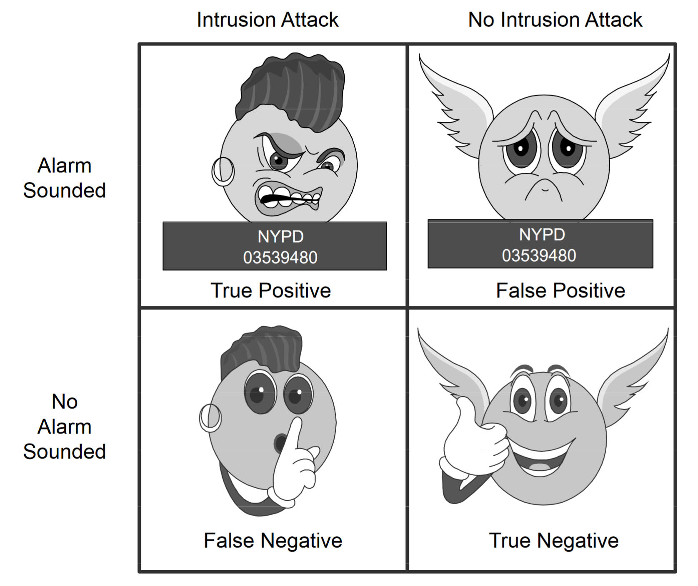
4.1 Intrusion Detection Events
True positive: when an alarm is sounded on a malicious event, which is an intrusion
True negative: when an alarm is not sounded on benign activity, which is not an intrusion

Slide 39
4.2 Rule-Based Intrusion Detection
A technique used by intrusion detection systems to identify events that should trigger alarms is to use rules. These rules could identify the types of actions that match certain known profiles for an intrusion attack, in which case the rule would encode a signature for such an attack.
Thus, if the IDS manager sees an event that matches the signature for such a rule, it would immediately sound an alarm, possibly even indicating the particular type of attack that is suspected.

Slide 40
4.2 Rule-Based Intrusion Detection
Rule-based intrusion detection can be a powerful tool to detect malicious behavior, because each rule identifies an action that policy makers have thought about and have identified as clearly being suspicious.
Thus, the potential for annoying false-positive alarms is low, because the policy makers themselves have determined the list of rules

Slide 41
4.3 Statistical Intrusion Detection
One of the main approaches to intrusion detection is based on statistics. The process begins by gathering audit data about a certain user or host, to determine baseline numerical values about the actions that that person or machine performs.
Numerical values that can be derived include:
Count, average, percentage, metering, time-interval length

Slide 42
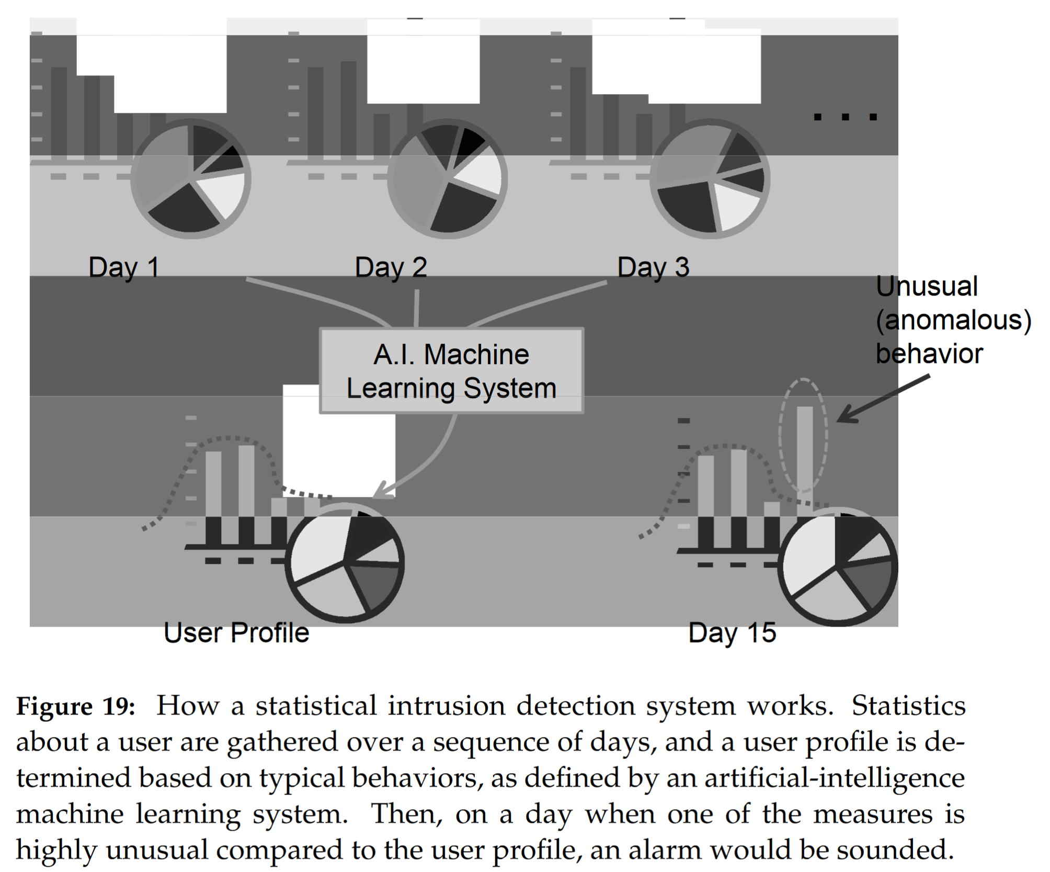
4.3 Statistical Intrusion Detection

Slide 43
4.4 Port Scanning
Determining which traffic is permitted through a firewall and which ports on a target machine are running remote services is a crucial step in analyzing a network for security weaknesses.
Any technique that allows a user to enumerate which ports on a machine are accepting connections is known as port scanning.
Ports may either be open (accepting connections), closed (not accepting connections), or blocked (if a firewall or other device is preventing traffic from ever reaching the destination port).

Slide 44
4.4 Port Scanning
Port scanning has a somewhat controversial legal and ethical standing: while it may be used for legitimate purposes to evaluate the security of one’s own network, it is also commonly used to perform network reconnaissance in preparation for an attack.

Slide 45
4.5 Honeypots
Another tool that can be used to detect intrusions, including port scans, is a honeypot. This is a computer that is used as “bait” for intruders.
It is often placed on network in a way that makes it attractive, such as having it configured with software with known vulnerabilities and having its hard drive full of documents that appear to contain company secrets or other apparently valuable information.

Slide 46
4.5 Honeypots
A honeypot computer is an effective tool for the following reasons:
Intrusion detection. Since attempts to connect to a honeypot would not come from legitimate users, any connections to a honeypot can be safely identified as intrusions.
Evidence. Appealing documents on a honeypot computer encourage an intruder to linger and leave evidence that can possibly lead to the identification of the intruder and/or his location.
Diversion. A honeypot also may appear to be more attractive to potential intruders than legitimate machines, distracting intruders from sensitive information and services.

Slide 47
5. Wireless Networking
The advent of wireless networking, has introduced many new challenges in providing security to users who may be wirelessly transmitting information that may include untrusted parties. Such challenges include the following:
Packet sniffers, session hijacking, interloping, legitimate users

Slide 48
5.1 Wireless Technologies
As with all Internet traffic, wireless communications on the Internet make use of the layered IP stack. In wireless networking, parties connecting to a network are referred to simply as clients, while a wireless router or other network interface that a client connects to is known as an access point (AP).
Instead of relying on the Ethernet protocol at the physical and link layers, most wireless networks rely on the protocols defined by the IEEE 802.11 family of standards, which define methods for transmitting data via radio waves over predefined radio frequency ranges.

Slide 49
5.2 Wired Equivalent Privacy (WEP)
The Wired Equivalent Privacy (WEP) protocol was incorporated into the original 802.11 standard with the goal of providing confidentiality, integrity, and access control to a wireless LAN.
WEP encrypts each data frame using a stream cipher, which is a symmetric cryptosystem where the ciphertext C is obtained as the exclusive OR of the plaintext message M and a pseudo-random binary vector S generated from the secret key, called keystream

Slide 50
5.3 Wi-Fi Protected Access (WPA)
Once the weaknesses in RC4 and WEP were published, IEEE quickly developed new standards that met more rigorous security requirements. The Wi-Fi Alliance then developed a protocol based on this standard known as Wi-Fi Protected Access (WPA).
WPA is a more complex authentication scheme that relies on several stages of authentication.

